Slide 1


Slide 2

Information System Lab Presentation
Presented By:
Mithun Chandra Das
ID- 16101200

Slide 3

SUP Grocery Shop BD

Slide 4

After this presentation we will able to understand.
Features
Common Features
Major Features
Flow Chart
Technology
Support & Maintenance

Slide 5

Features
Common Features-
User Friendly Homepage
Login / Register
New Arrivals / Offers
Shipping Policy
Wish list
Admin Panel
Major Features-
Responsive Web Design
Zooming Image in Product
Rating & Review Options
Compare Section
Product Search(by Category & Price).

Slide 6







Technology
HTML5, CSS3
JAVASCRIPT, JQUERY
BOOTSTRAP
PHP

Slide 7
Customer
Have an account?
Plan for buying product
No
Create Account
Received Customer
Visit Website
Yes
Order Proceed
Login
Search Product
Payment
Online
Bkash, DBBL, NEXUS PAY
Product is Available
No
Offline
Placed to Order
Check amount
Yes
Order Confirmed
Continue
Payment
Add to Cart

Slide 8
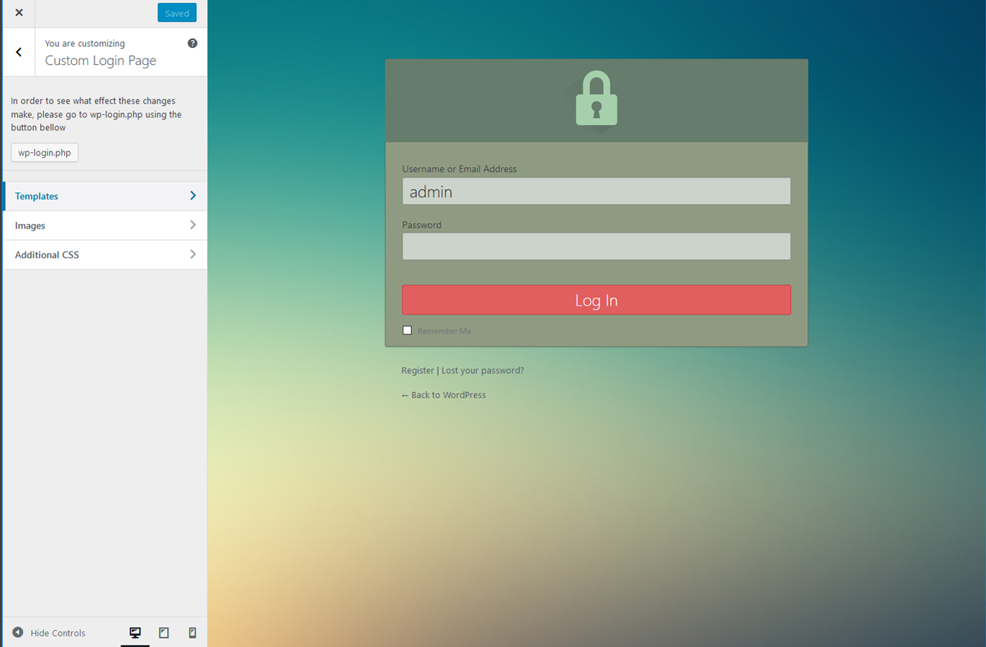
Admin Panel
Login session.
Maintain category
Product Maintain
Upload Product
Edit Product
Delete Product
See Customer Order
Live Chat with Customer
Maintain Order shipping
Update or Edit Brand
Update slider

Slide 9


